Slide 1

CAPSTONE PROJECT
LEAD SCORES ANALYSIS
- PRAGATI JHA

Slide 2
PROBLEM STATEMENT
Introduction
X Education, an online learning platform, offers courses tailored for industry professionals. The company promotes its courses through various websites and search engines like Google.
Visitors to the website may explore courses, watch videos, or fill out inquiry forms. When a visitor provides their email or phone number, they are classified as a lead. Additionally, leads are generated through past referrals.
Once acquired, the sales team engages with these leads through calls and emails to convert them into customers. The company's typical lead conversion rate is around 30%.
Business Goals
X Education aims to identify high-potential leads, also known as “Hot Leads.”
To achieve this, the company requires a predictive model that assigns a lead score, where higher scores indicate a greater likelihood of conversion. This system will help prioritize leads with a higher probability of becoming customers.
The CEO has set a target lead conversion rate of 80%, emphasizing the need for an efficient lead qualification process.

Slide 3
OVERALL APPROACH
1. Data Cleaning & Preprocessing: Handled missing values, removed irrelevant levels (e.g., ‘Select’), and performed feature engineering
2. Exploratory Data Analysis (EDA): Identified key patterns and correlations using visualizations.
3. Logistic Regression Model: Built and optimized a model to predict conversion likelihood.
4. Evaluation Metrics: Used Accuracy, Precision, Recall, F1-score, and AUC-ROC for performance assessment.
5. Conclusion and Recommendation

Slide 4
Data Cleaning & Preprocessing
Converting the variable with values YES/NO to 1/0.
Converting the ‘SELECT’ values with NANs.
Dropping the3 columns having>70% of null values
Dropping unnecessary columns.
Dropping the rows as the null values were<2%.

Slide 5
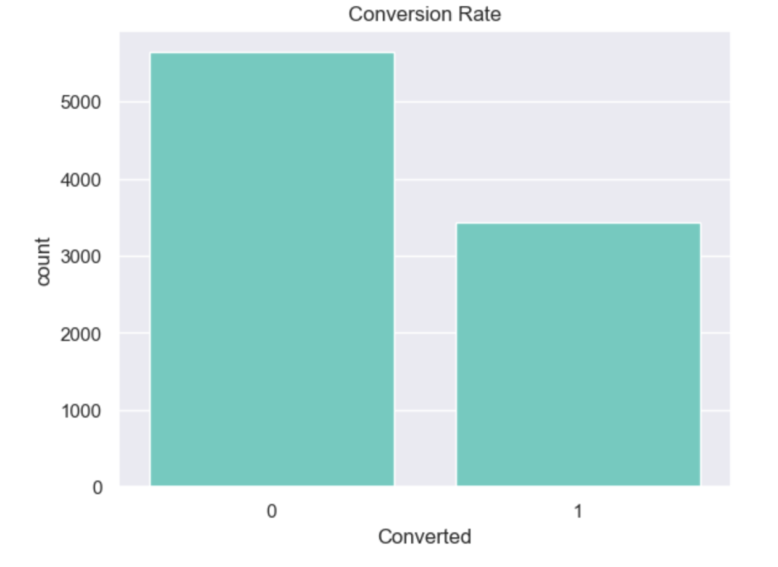
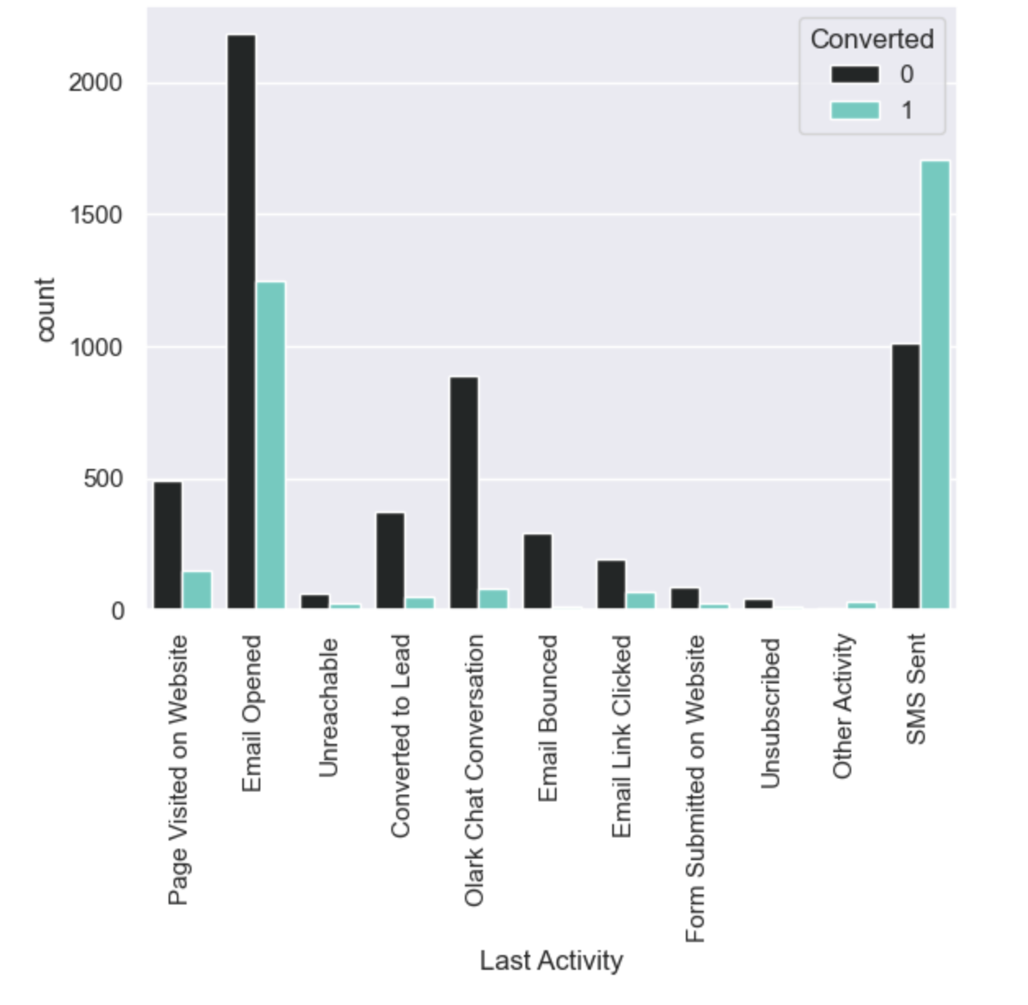
EXPLORATORY DATA ANALYSIS
The count of leads whose last activity was "Email Opened" is the highest.
The conversion rate is highest when the last activity was "SMS Sent".
We have around 30% conversion rate

Slide 6
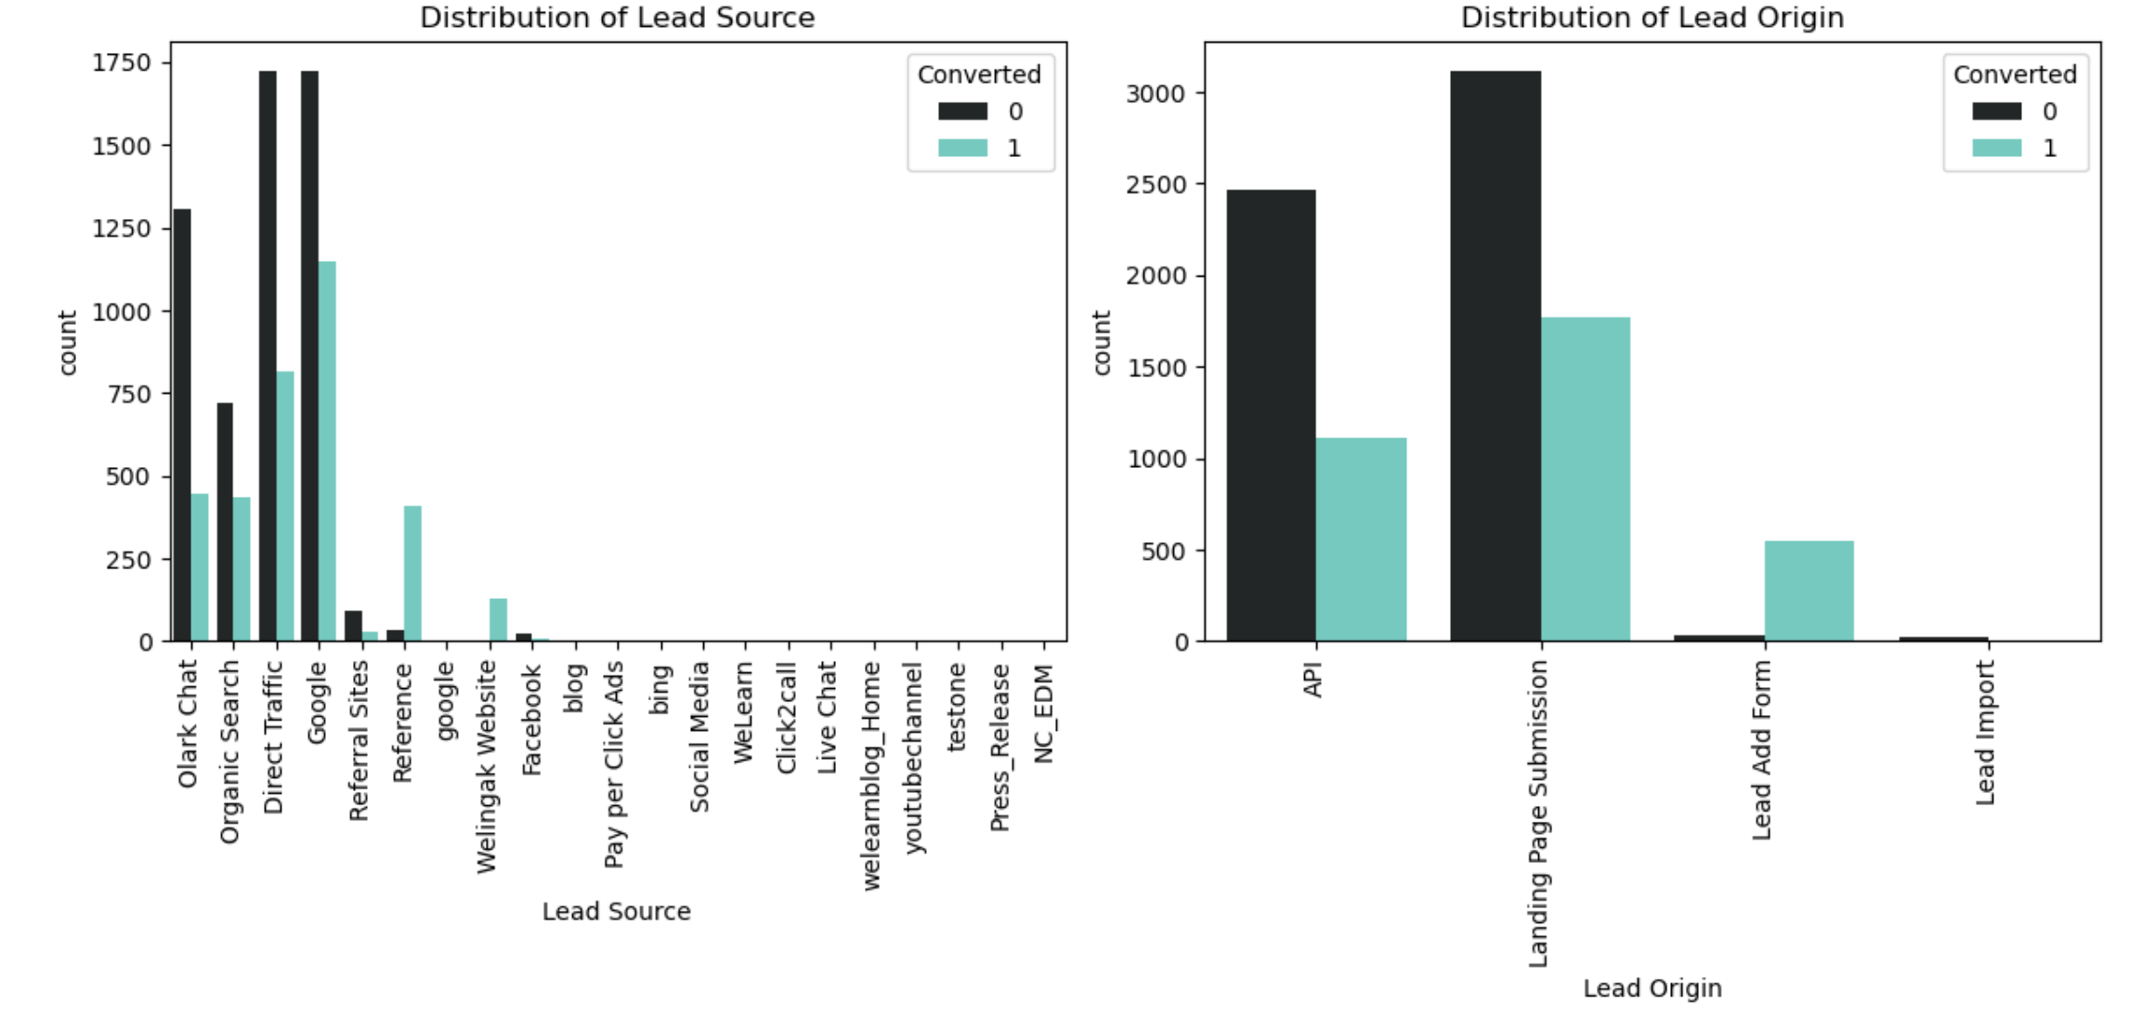
EXPLORATORY DATA ANALYSIS
The count of leads from Google and Direct Traffic is maximum.
The conversion rate of the leads from Reference and Welingak Website is maximum.
API and Landing Page Submission have a lower conversion rate (~30%) but a considerable number of leads.
The count of leads from the Lead Add Form is low, but the conversion rate is very high.

Slide 7
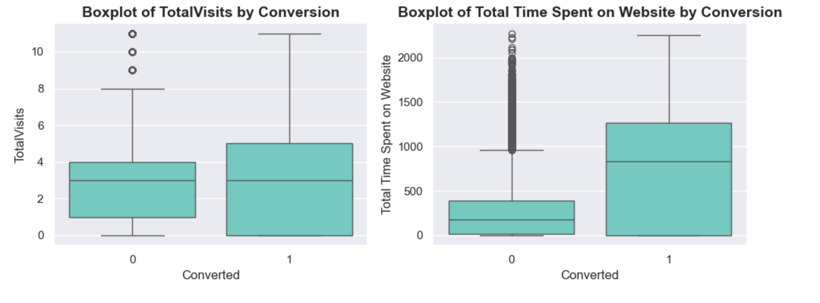
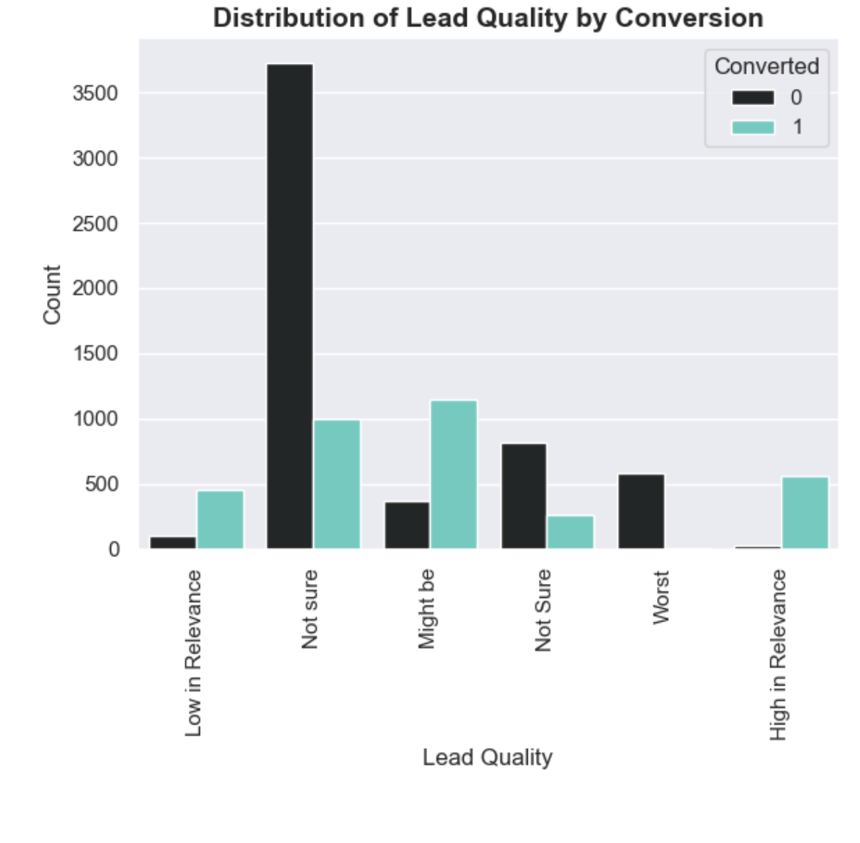
EXPLORATORY DATA ANALYSIS
The median of both conversion and non-conversion is the same, making it inconclusive for decision-making.
Users who spend more time on the website are more likely to convert.
Most leads fall under "Not Sure," but their conversion rate is low.
Leads labeled "High in Relevance" have the highest conversion rate.
Focusing on high-relevance leads can improve overall conversions.

Slide 8
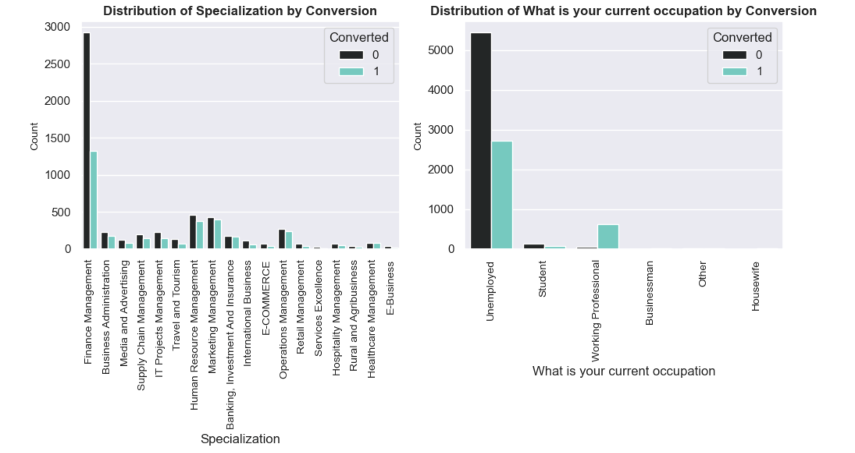
EXPLORATORY DATA ANALYSIS
"Other Specialization" has the most leads but low conversions.
"Business Administration" shows better conversions.
"Marketing" and "Finance Management" have moderate conversions.
Most leads are unemployed but have a low conversion rate.
"Working Professionals" have a high conversion rate.
"Students" and "Businessmen" have fewer leads with moderate conversions.

Slide 9
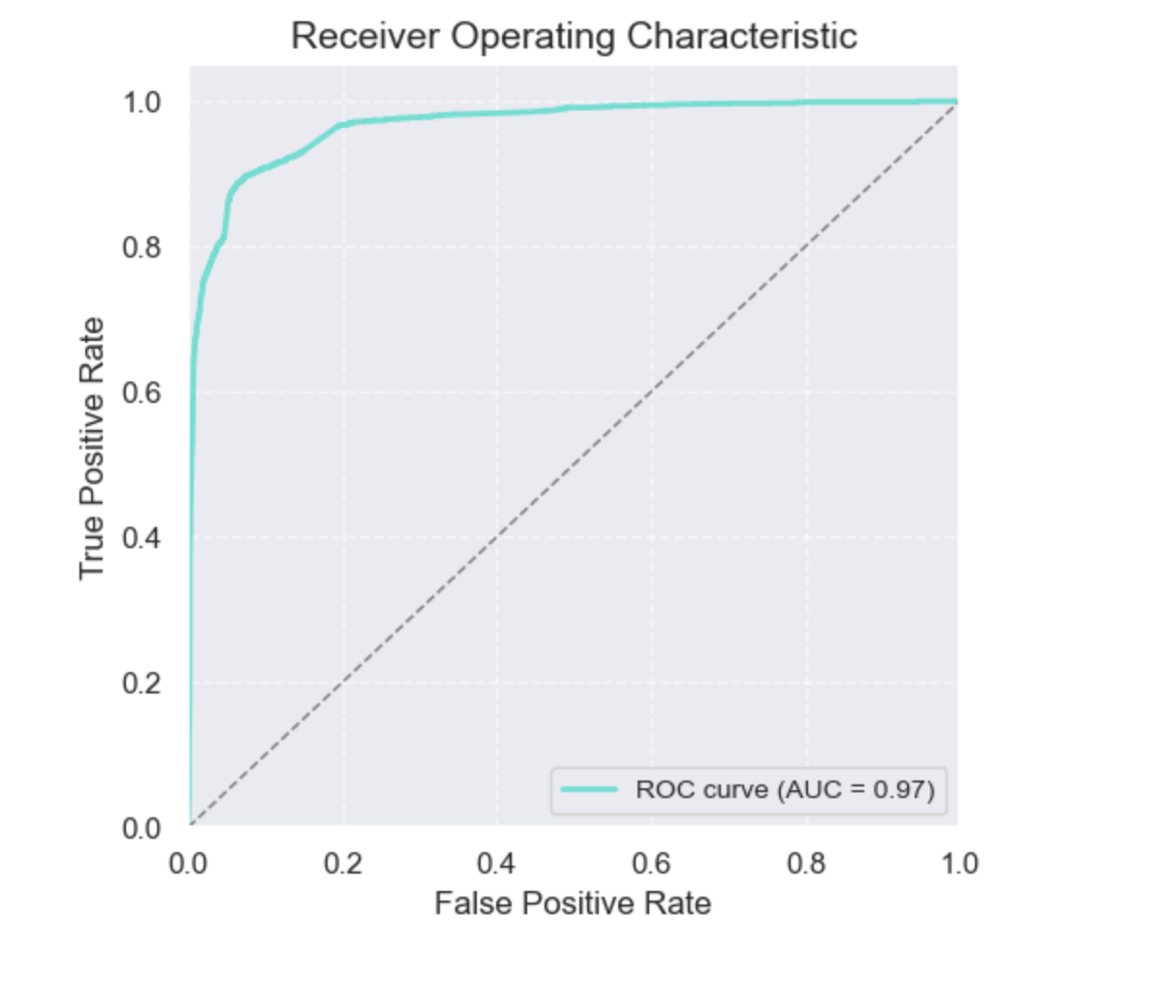
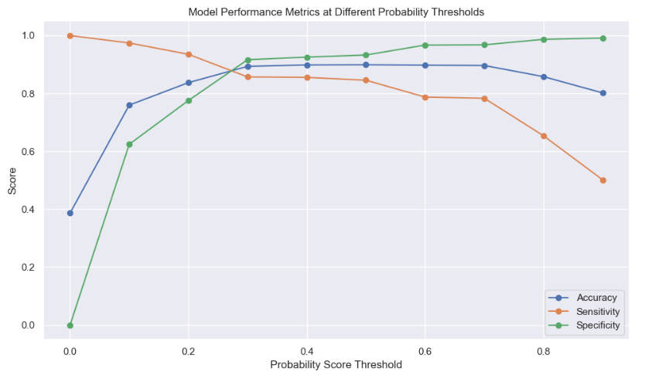
MODEL BUILDING
ROC CURVE
SPLITTING THE DATA INTO TEST AND TRAINING SETS
WE HAVE CHOSEN THE TRAIN_TEST SPLIT RATIO AS 70:30
USING RFE TO CHOOSE TOP 17 VARIABLES
BUILD MODEL BY REMOVING THE VARIABLE
WHOSE p-VALUE > 0.05 AND VIF > 10
PREDICTIONS ON TEST DATASET
OVERALL ACCURACY IS 92.29%
OPTIMAL CUTOFF

Slide 10
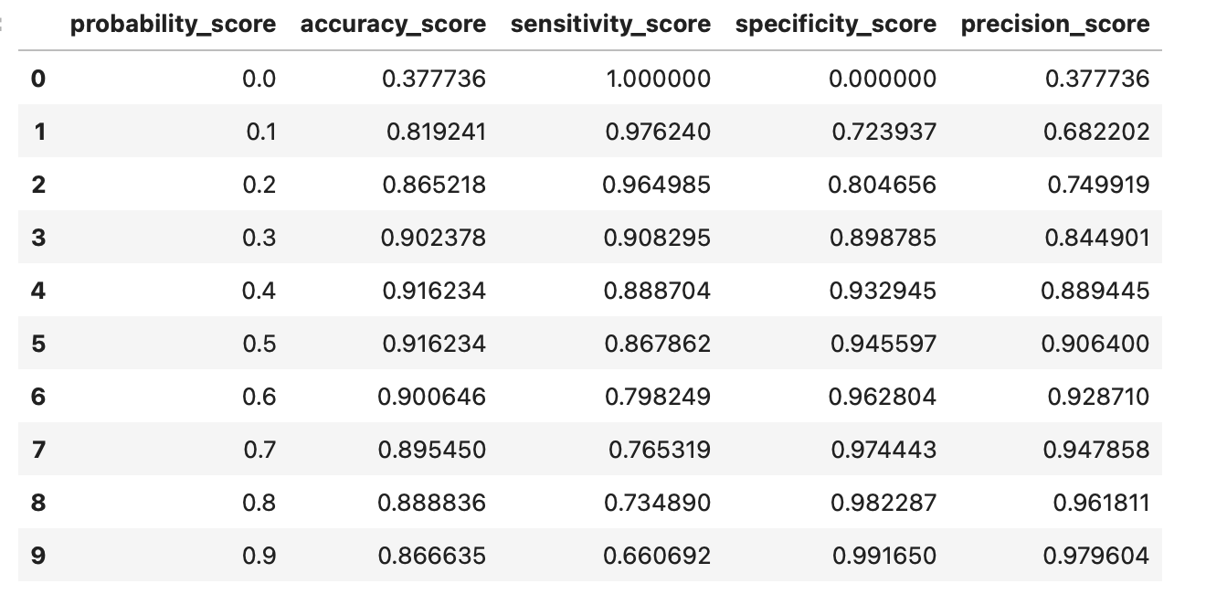
MODEL EVALUATION
CALCULATED ACCURACY, SENSITIVITY, AND SPECIFICITY FOR VARIOUS PROBABILITY CUTOFFS FROM 0.1 TO 0.9
AS PER THE GRAPH AND LOOKING AT THE OTHER SCORES, IT CAN BE SEEN THAT THE OPTIMAL POINT IS 0.45
TRAIN DATA CONFUSION MATRIX
PERFORMANCE METRIC
PREDICTED ACTUAL | NOT CONVERTED | CONVERTED
NOT CONVERTED | 3737 | 215
CONVERTED | 317 | 2082
ACCURACY | 91.62%
PRECISION | 90.64%
SENSITIVITY | 86.79%
SPECIFICITY | 94.56%

Slide 11
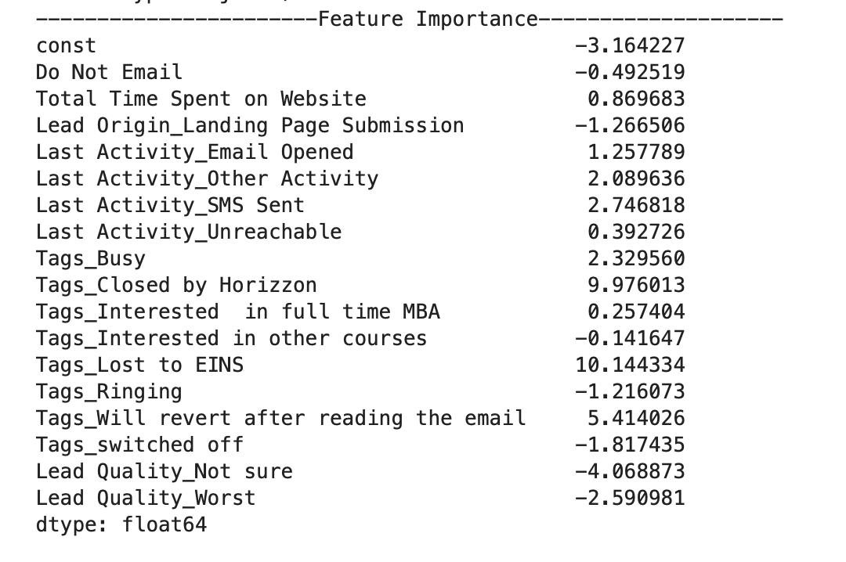
MODEL PREDICTION
TEST DATA CONFUSION MATRIX
PREDICTED ACTUAL | NOT CONVERTED | CONVERTED
NOT CONVERTED | 1582 | 105
CONVERTED | 105 | 931
PERFORMANCE METRIC
ACCURACY | 92.29%
PRECISION | 89.86%
SENSITIVITY | 89.86%
SPECIFICITY | 93.78%

Slide 12
CONCLUSION
The logistic regression model is used to predict the probability of conversion of a customer.
While we have calculated both sensitivity-specificity as well as Precision-Recall metrics, we have considered the optimal cut-off on the basis of sensitivity-specificity for final prediction.
Lead Score calculated shows the conversion rate of the final predicted model is around 92% in test data as compared to 95% in train data.
In business terms, this model has the capability to adjust with the company’s requirements in the coming future.
TOP variables that contribute to lead getting converted in the model are:
Tags_Lost to EINS
Tags_Closed by Horizon
Lead Quality_Worst
Hence, overall this model seems to be good.

Slide 13

The End…

